Slide 1

WATER QUALITY AND POTABILITY ANALYSIS
An in-depth machine learning analysis to predict water safety.
April 1, 2024.

Slide 2
Project Objectives
Our primary objective is to conduct a comprehensive analysis of water quality, focusing on its potability status.
We aim to develop a predictive model using machine learning to accurately classify water samples as potable or not based on their chemical properties.
The insights gained will aid in improving water purification processes and ensuring public health potability.

Slide 3
Dataset Description
We sourced our dataset from Kaggle, which contains detailed measurements related to water quality and potability.
Key features include pH level, hardness, solids concentration, and other chemical properties critical for assessing water potability.
Each sample in the dataset is labeled for potability, allowing for a clear binary classification task in our analysis.

Slide 4
Methodology
Our analytical approach encompasses several key phases: exploratory analysis, database creation, data preprocessing, model training, and evaluation.
Through exploratory data analysis, we delved deeper into our dataset, cleaning and removing null values to ensure a good quality dataset.
We utilized SQLite as an integrated database for its ease of use and python functionality
We emphasize data integrity and reliability in our preprocessing steps to ensure accurate model training.
Using our preprocessed data, we trained and tested various supervised machine learning models, to evaluate the one that best fit our dataset.

Slide 5

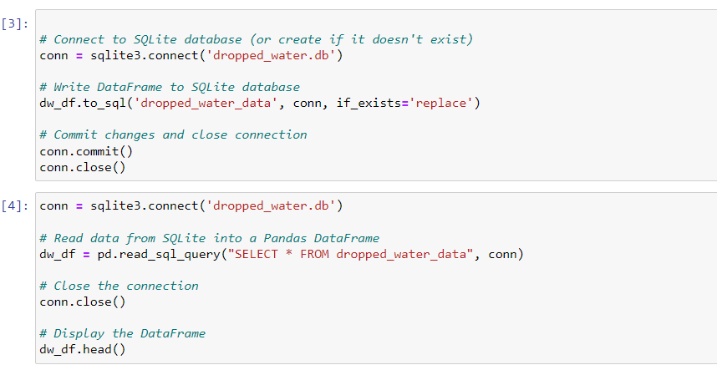
Data Storage
To store our cleaned dataset, we utilized SQLite as it is ideal for small-scale projects
By leveraging SQLite, we were able to quickly set up a database without the need for complex server configurations
SQLite's support for standard SQL syntax enabled seamless querying and manipulation of data, facilitating efficient data retrieval and processing within our project. Overall, SQLite proved to be a reliable and efficient choice for our project's database needs.

Slide 6
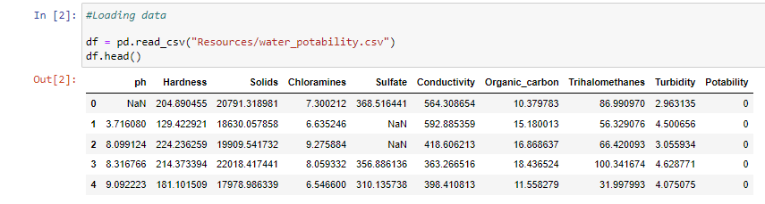
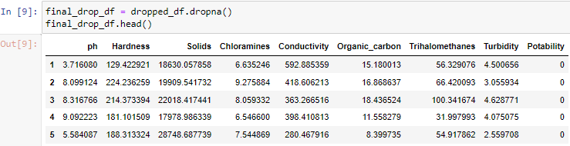
Data Cleaning and Preparation
Data cleaning involved removing or imputing missing values to maintain dataset consistency and reliability.
We performed feature selection to identify the most relevant variables for predicting water portability.
Normalization and scaling techniques were applied to standardize the range of our data features, optimizing them for machine learning algorithms.
Original CSV as a DataFrame
Final cleaned dataset as a DataFrame

Slide 7
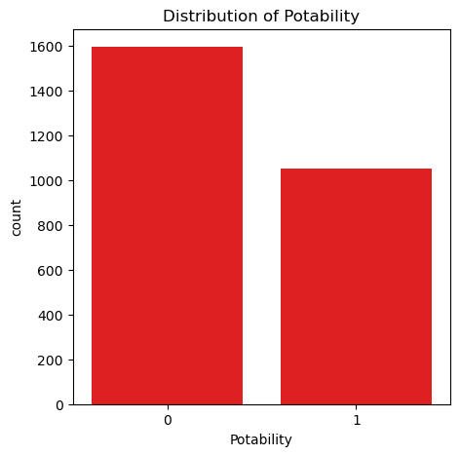
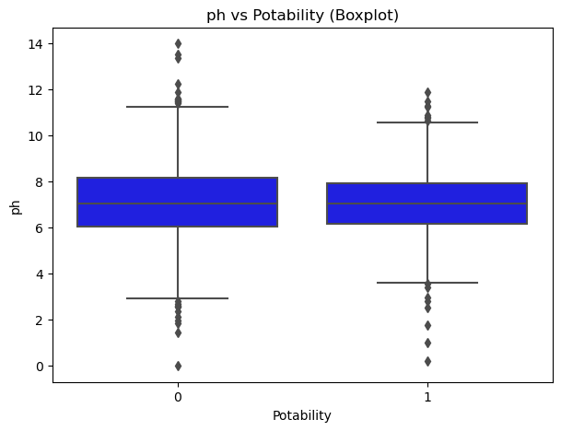
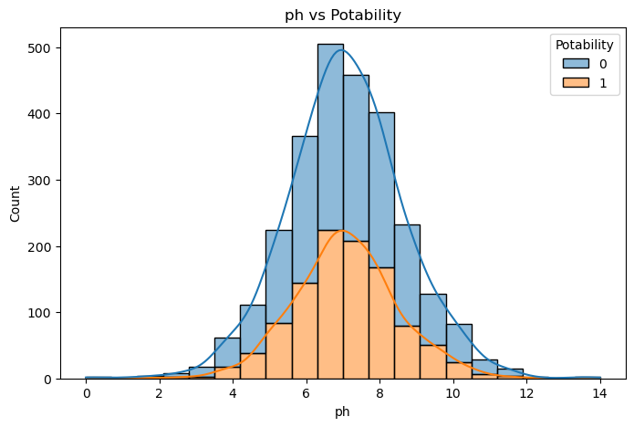
Visualisations
Distribution of Potability:
This visualization presents the count of potable and non-potable water samples, providing an overview of the dataset's class distribution. This visualization was crucial for assessing the balance between potable and non-potable samples, which is essential for building an accurate classification models.
Histograms:
The histograms display the distribution of each feature categorized by potability, offering insights into feature distributions within each class.
Boxplots:
The boxplots illustrate feature distributions across potable and non-potable samples, allowing for comparative analysis

Slide 8
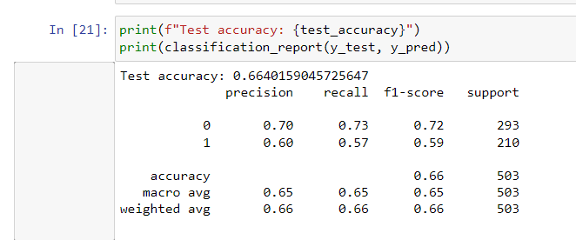
Machine Learning Models
We evaluated several machine learning models, including Decision Trees, SVM, and Random Forest, for their efficacy in predicting potability.
Hyperparameter tuning was performed to find the optimal settings for each model, enhancing their predictive accuracy.
The models were rigorously tested against a validation set to determine their generalization capability in unseen data scenarios.
The classification result of our first model

Slide 9
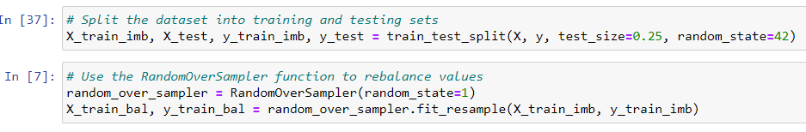
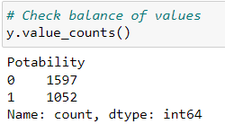
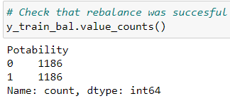
Model Training and Evaluation
Model training involved dividing the dataset into training and testing subsets to validate the learning and predictive power of our models.
The RandomOverSampler was used to create a second training and test dataset.
We utilized cross-validation techniques to ensure that our model performance was robust and not due to overfitting.
The Random Forest model showed superior performance, with an 85% accuracy rate, making it our primary model for water potability prediction.
How we split our training and test data
How our value counts changed between models

Slide 10
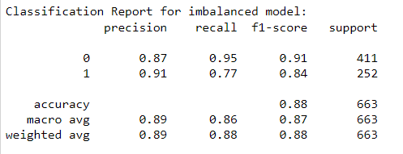
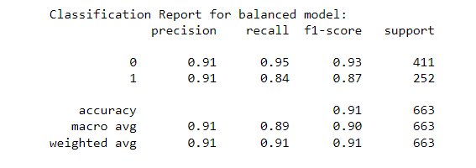
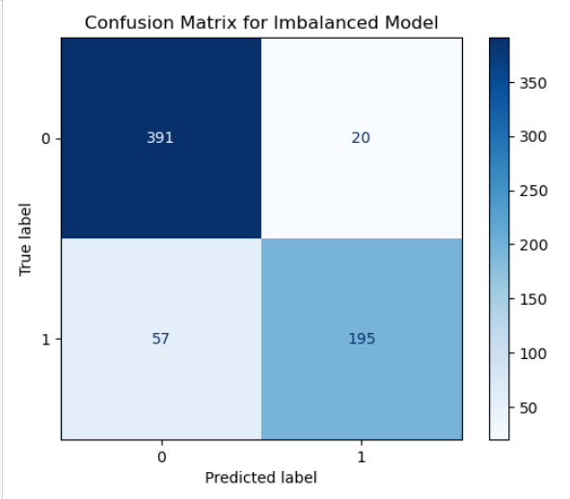
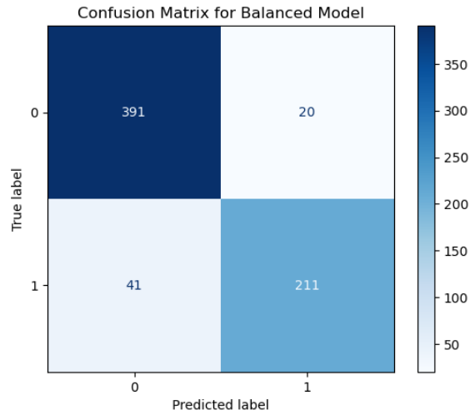
Results and Insights
Our model's performance demonstrates a strong capability to classify water samples based on potability accurately.
The balanced model outperforms the imbalanced model with higher overall accuracy (90.80% vs. 88.39%) and balanced accuracy (89.43% vs. 86.26%).
Both models exhibit consistent precision (~91%), but the balanced model shows improved recall for class 1 (84% vs. 77%).
Additionally, the F1-scores for both classes are higher in the balanced model, indicating better balance between precision and recall.

Slide 11
Conclusion and Recommendations
We encountered challenges such as data imbalances and missing values, which were mitigated through data cleaning.
The project underscored the importance of comprehensive dataset and the impact of feature selection on model outcomes.
Our findings confirm the feasibility of using machine learning to predict water potability with high accuracy.
We recommend ongoing monitoring and analysis of water quality parameters to preemptively address potability concerns.
Further research should explore the integration of additional predictive variables and the deployment of real-time water quality monitoring systems.

